Slide 1

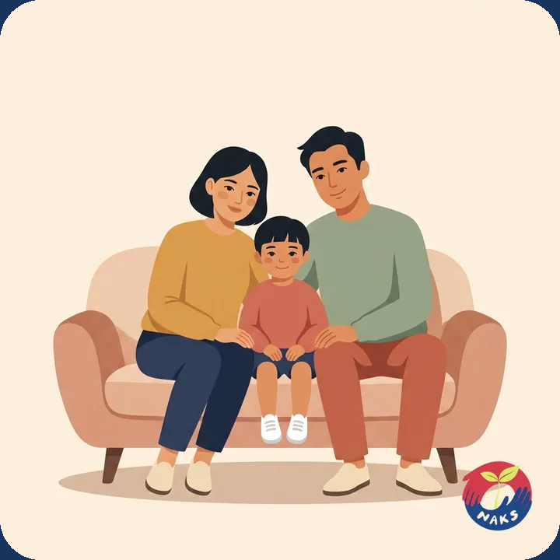


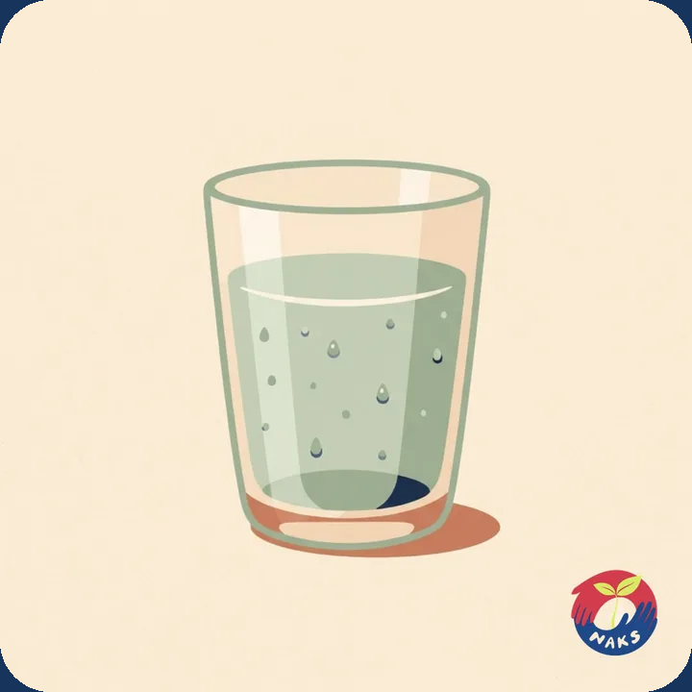
NORTH ALABAMA KOREAN SCHOOL
한국어 실험실
Korean Lab
Learn Korean the way you learned your first language —
by looking at a picture and hearing the word.
Free · No app store · Any phone
northalabamakoreanschool.org/learn-korean
Notes:
Open with this. Korean Lab is free, made by our own school, and it runs in the phone's browser — nothing to download. Today I'll show you how it works, then get it onto your phones before you leave.

Slide 2
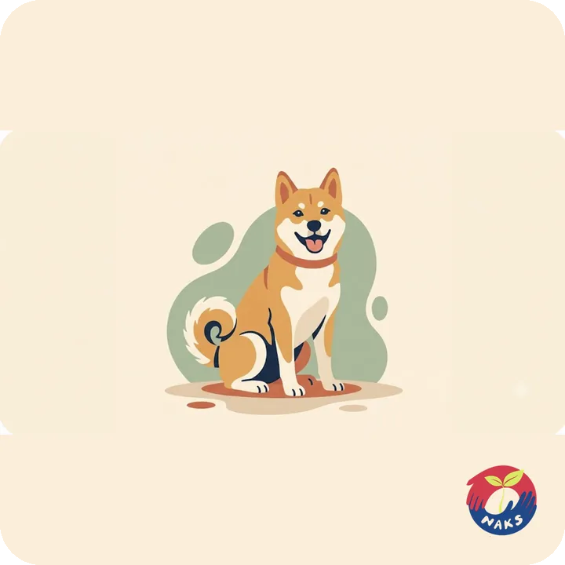
한 장의 카드
How a card works
1
One picture. One word.
You see the picture and hear a native speaker say the word. English is there if you want it, and it hides with one tap.
2
Tap the picture — a different voice answers.
Four native speakers share every word, so you learn the sound itself and not one person's version of it.
3
“I know this” — and it leaves the stack.
개 dog
The deck shrinks as you go. There is no pile of overdue cards waiting to make you feel behind.
Notes:
Demo cue: open the site on the projector, swipe two or three cards, and tap the picture twice so they hear two different speakers. Then press 'I know this' so they see the card leave.

Slide 3
왜 다른가 · Why it's different
It teaches the words most commonly used—
in the order that “pays-off” fastest.
Most-used first.
295
37%
The 1,500 most common spoken words were ranked, and the picturable ones were put in frequency order.
picture cards,
built for this school
of everything said in
everyday spoken Korean
It measures how well you know each word.
Every answer updates a confidence score — right or wrong, how fast, what you confused it with. The words you are shakiest on come back; the solid ones stay away.
It won't bury you.
If too much of what you've learned has gone soft, new words pause until your base is healthy again. You never carry a backlog.
Sources and the full arithmetic behind 37% are published inside the app.
Notes:
The 37% number is honest and it is explained in the app itself — tap the coverage line at the bottom of the Progress page. It counts content words in everyday spoken Korean, not all words.

Slide 4





보상 · What you earn
Medals you grow, and music you unlock.
씨앗
새싹
꽃
무궁화
Seed
Sprout
Bloom
Mugunghwa
The stereo
100 words
500 words
1,000 words
1,500 words
It arrives dusty. Fifty proven words cleans it up, and every medal after that adds another song.
Fifteen medals in all — the same 씨앗 → 무궁화 ladder our classes use.
Notes:
Kids chase the medals; adults chase the songs. Nothing on screen ever counts down what is still locked — you only ever see what you have earned.

Slide 5
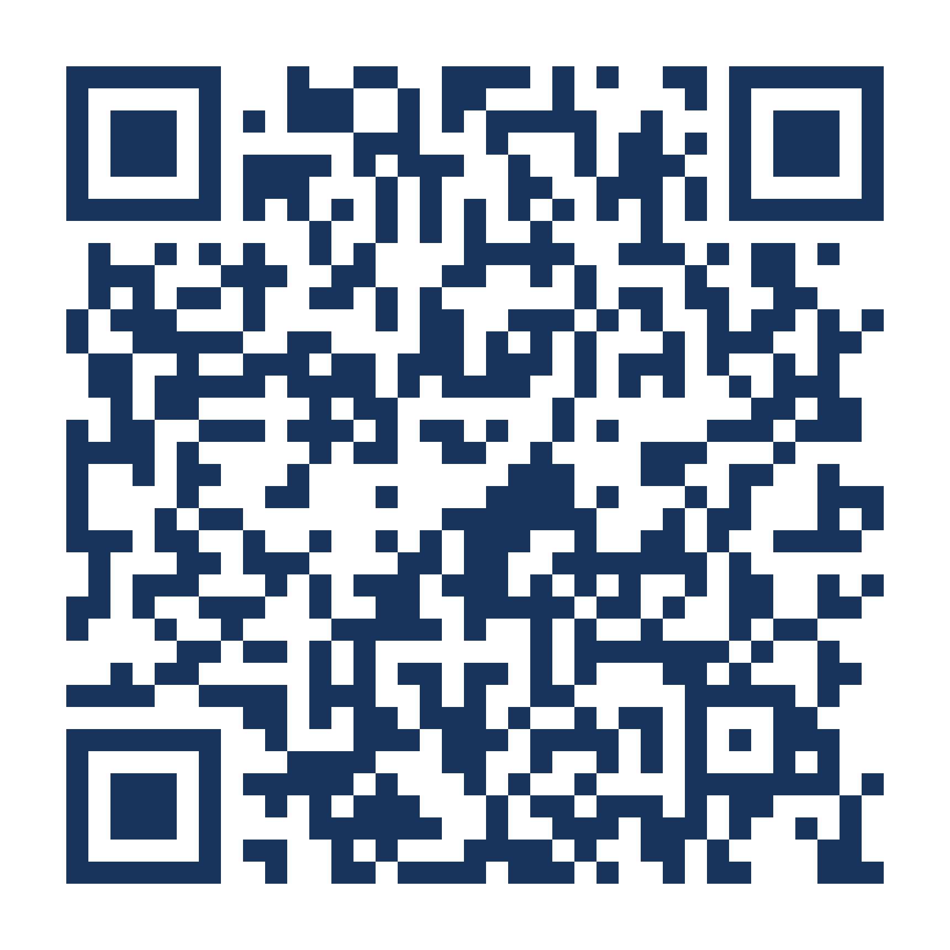
지금 시작하세요
Point your camera here.
No app to download. No account needed to start.
It opens straight into the first card.
Or type it in:
northalabamakoreanschool.org/learn-korean
Works on any phone, tablet or computer.
한국어 실험실 · Korean Lab
Notes:
Give them a full minute here. Walk the room and make sure every phone actually opened the page before moving on — the next slide only makes sense once the page is up.

Slide 6
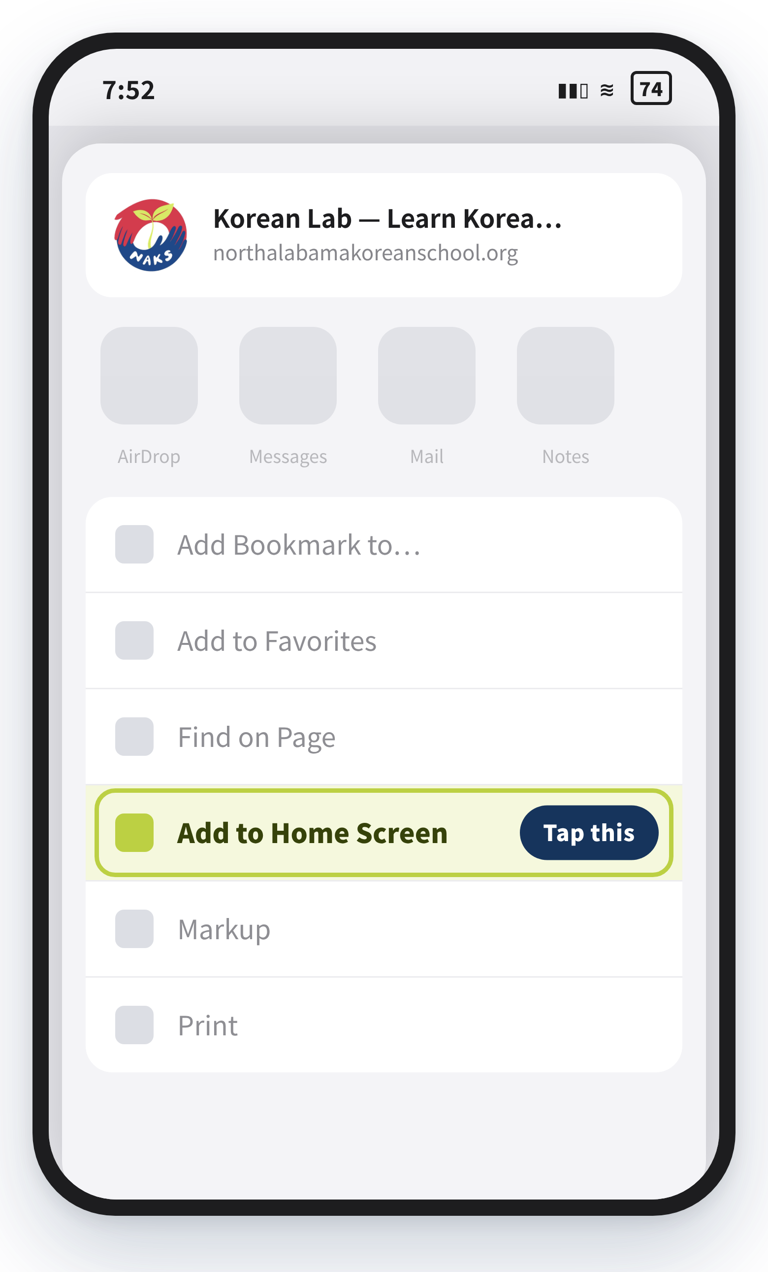
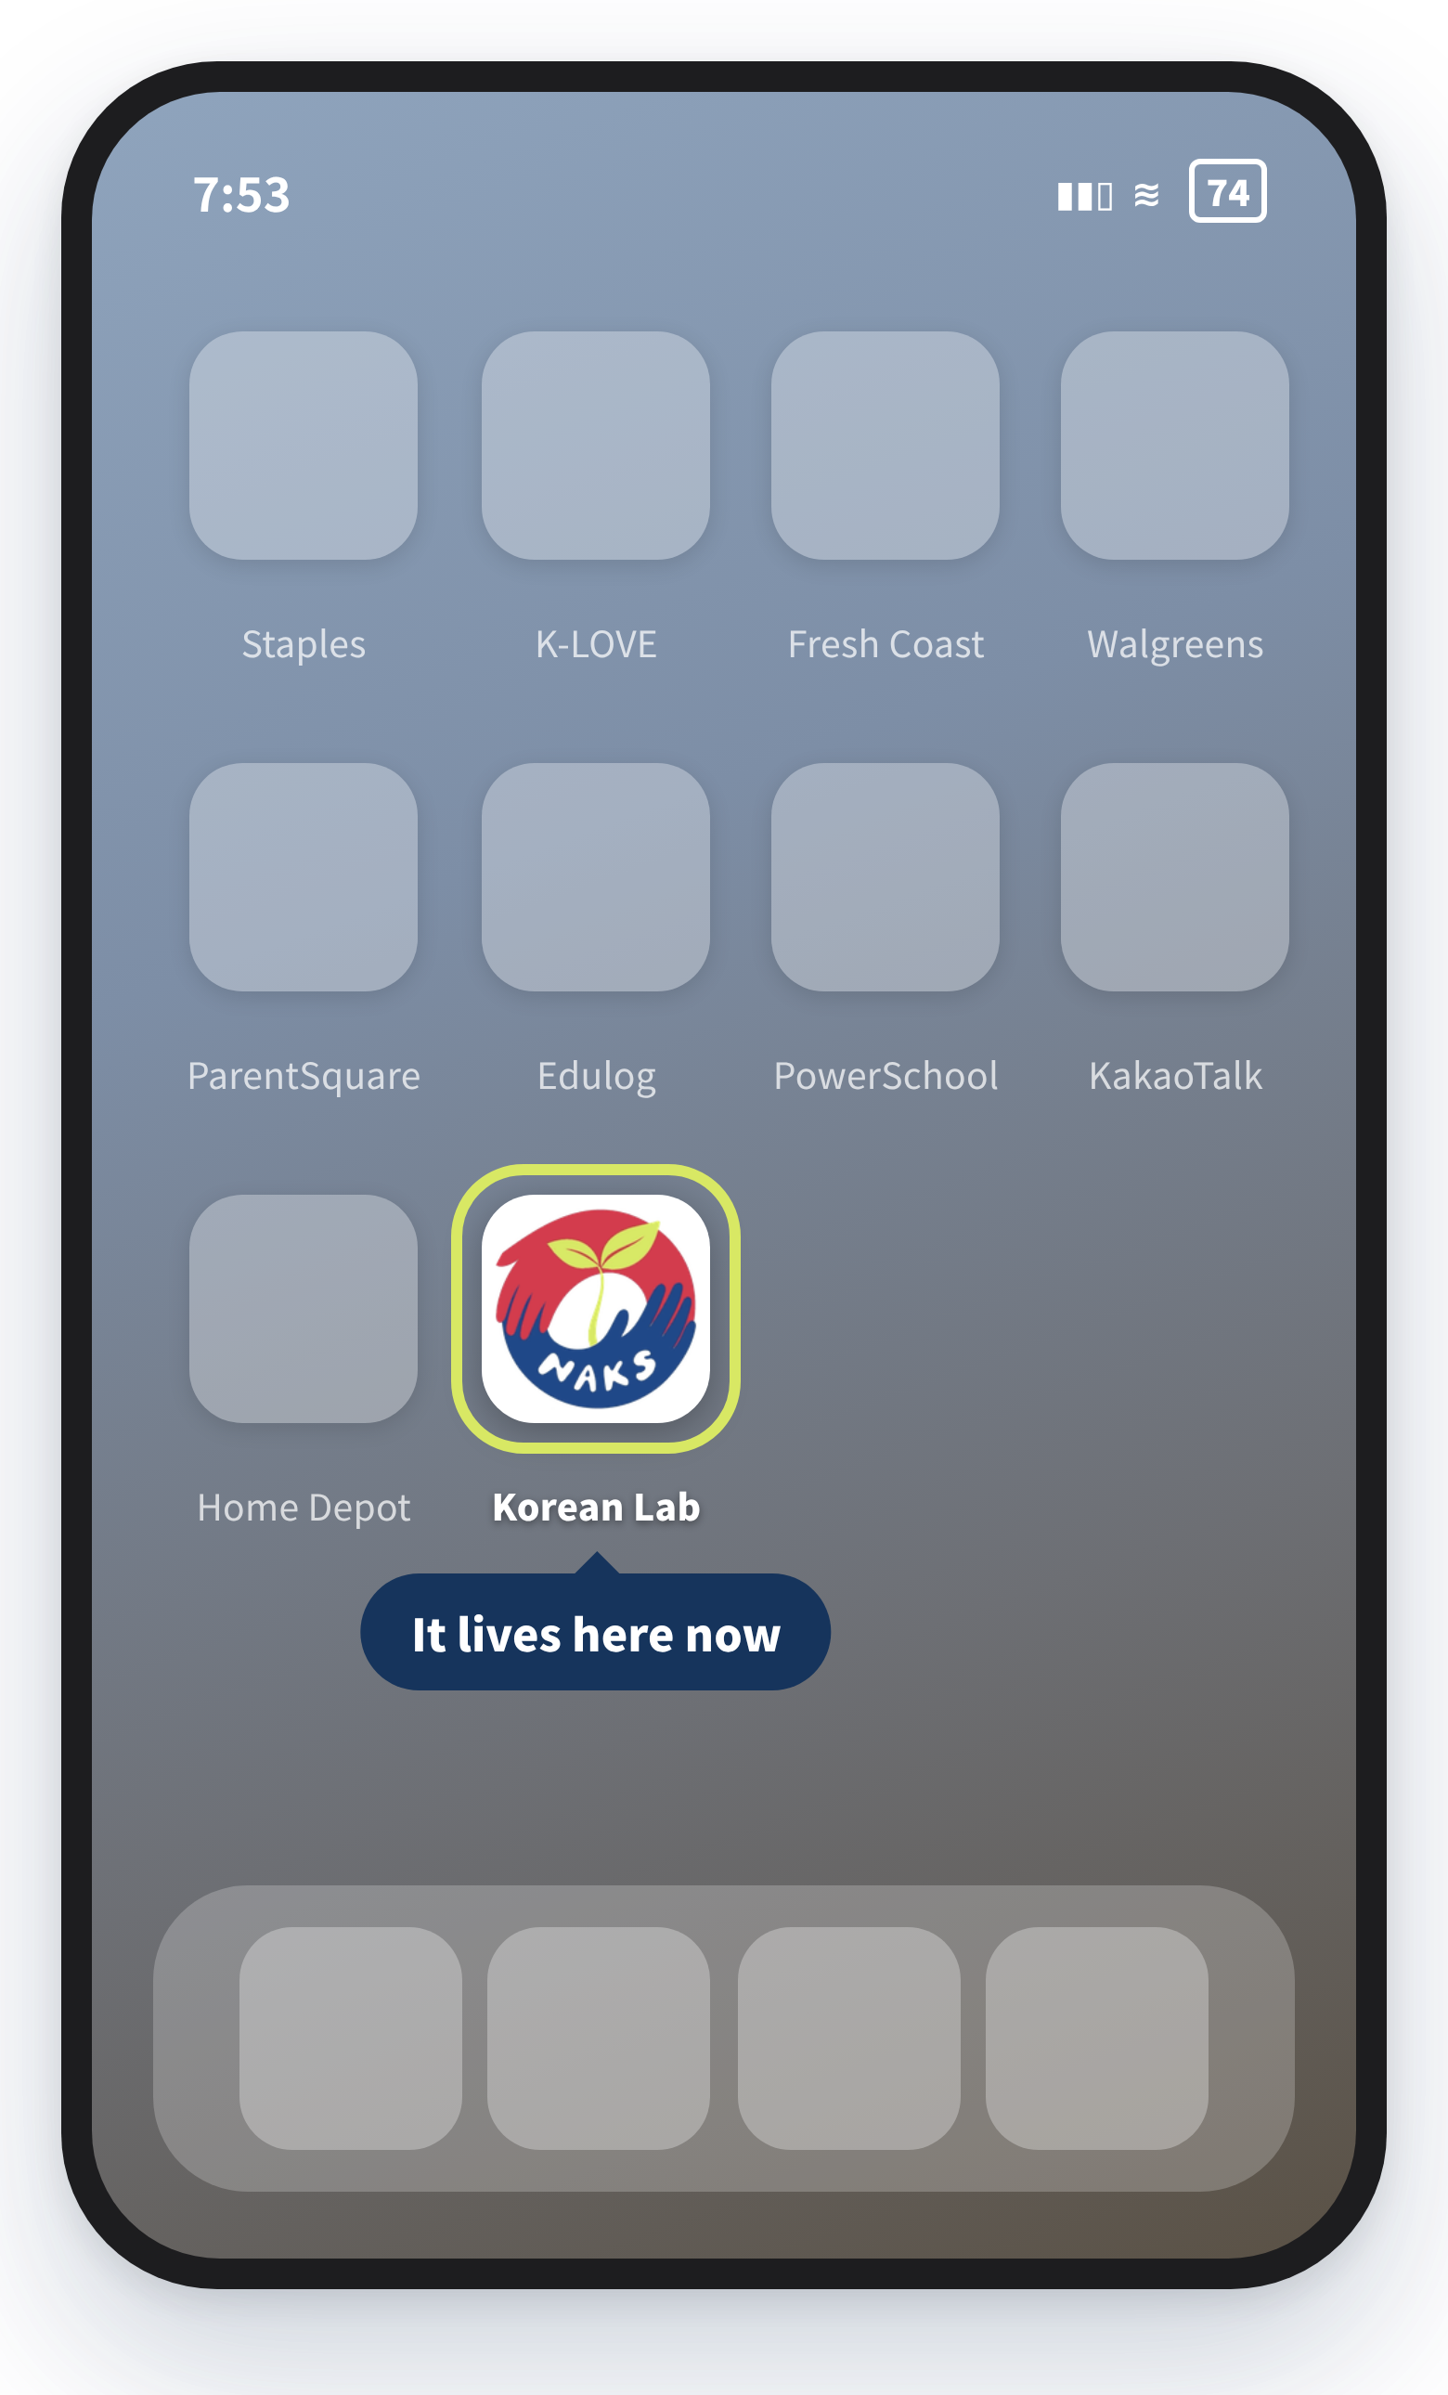

휴대폰에 저장하기 · Keep it on your phone
Two taps and it becomes an app.
1
Open the page in Safari (iPhone) or Chrome (Android).
2
Tap the Share button — the square with an arrow.
3
Scroll down and tap Add to Home Screen, then Add.
4
The icon lands on your home screen. Open it like any app.
Sign in with Google to save your progress.
Without it, your words, medals and history live only on that one phone — and they can be lost. Signing in also lets you choose your character and put your name on the Hall of Names.
The Share menu
Your home screen
Notes:
Say this part twice: sign in with Google, or the progress does not follow them. Everything else is optional; that one is not.

